Slide 1
Optoelectronic devices
Jinling Yu

Slide 2
Contents
Photodiode and solar cell
Light-emitting diodes (LEDs) and semiconductor lasers

Slide 3
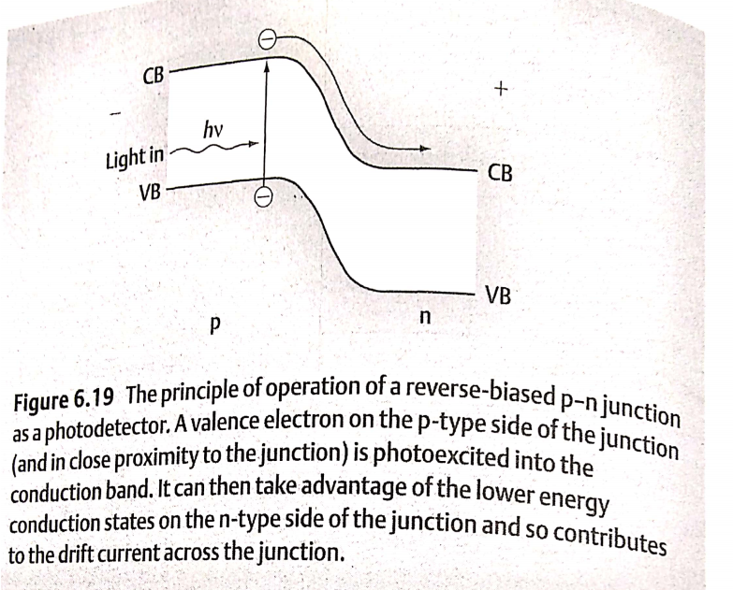
Photodiode
(1) PN junction under a reversed bias
(2) The energy of the light is larger than the band gap of the material
It convert the light energy into an electrical current.

Slide 4
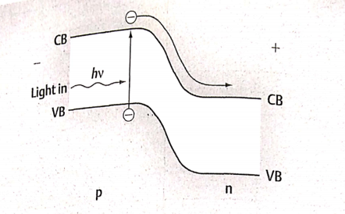
Photodiode
When a valence electron in the depletion region on the p-type side of the junction absorbs a photon of the appropriate frequency, the electron is excited into the conduction band where it becomes a minority carrier. It is then swept across into the n-type region by the strong electric field in the depletion layer and so contribute to the drift current.

Slide 5
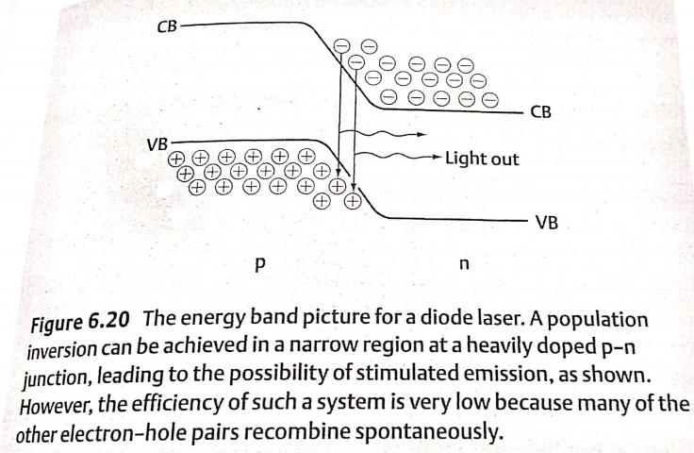
Light-emitting diodes (LEDs)
When electrons recombines with holes in semiconductors, they emit light.
Only direct gap semiconductor can be used for light-emitting devices, because they have higher transition properties.

Slide 6
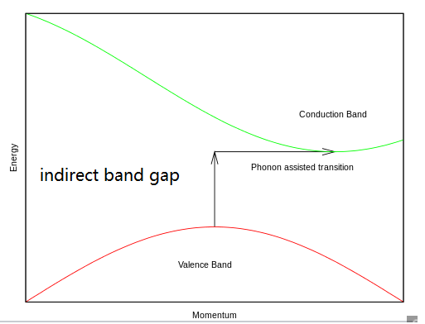
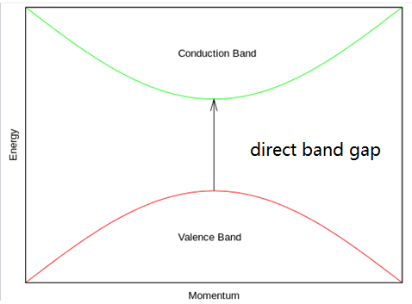
What is direct band gap semiconductor?
In semiconductor physics, the band gap of a semiconductor can be of two basic types, a direct band gap or an indirect band gap.
The band gap is called "direct" if the crystal momentum of electrons and holes is the same in both the conduction band and the valence band; an electron can directly emit a photon. In an "indirect" gap, a photon cannot be emitted because the electron must pass through an intermediate state and transfer momentum to the crystal lattice.

Slide 7
Light-emitting diodes (LEDs)
(1) It consists simply of a forward-biased p-n junction made from a direct band gap material.
(2) The wavelength of the emitted light depends on the band gap of the semiconductor, so by using different materials it is possible to produce light with a wide range of colours.
(3) The alloy gallium arsenide phosohide (GaAsP) can emit light across most of the visible spectrum—from red to green—simply by varying the phosphorus content of the material.

Slide 8
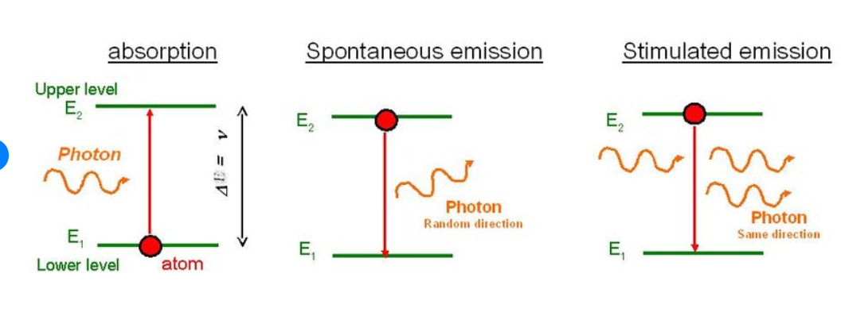
Light-emitting diodes (LEDs)
(4) In an LED, the photons are produced by spontaneous emission, i.e., the recombination of an electron and a hole is a random process which is independent of the recombination of other electrons and holes. So the emitted light is incoherent light.

Slide 9
Semiconductor laser
In order to make a semiconductor laser, we need to produce coherent light, which requires stimulated emission.
This means that the recombination of one electron-hole pair sets off other similar events, as a result, all of the photons that are produced are in phase with one another.

Slide 10
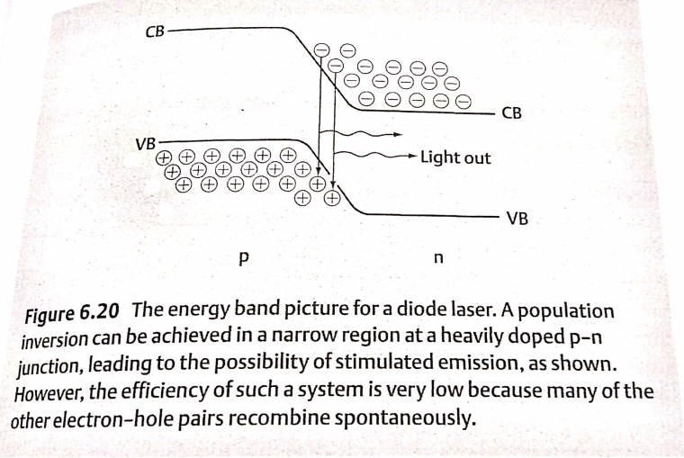
Semiconductor laser
A primary requisite of achieving stimulated emission is that we have a population inversion.
In other words, we need to have more electrons at the bottom edge of the conduction band than there are electrons at top edge of the valence band.
This situation can be achieved at a p-n junction, as shown in the following figure, but only if there are very high levels of doping.

Slide 11
Semiconductor laser
Unfortunately, the recombination events are spread out over a comparatively wide region but the population inversion exists only near the middle of the depletion region.
So large proportion of these events involves spontaneous, rather than stimulated, emission. This means that the lasing process has a low efficiency, and a very large current mut flow through the junction in order to replenish continually the supply of electrons and holes and so maintain the population inversion.

Slide 12
Semiconductor laser
In fact, the heat produced by this current is so large that it is usually only possible to operate the laser for short bursts or pulses.

Slide 13
Semiconductor laser based on heterojunctions
A vast improvement in efficiency can be archived by replacing the p-n junction with a heterostructure, or to be precise, two heterostructures, as shown in the following figure.

Slide 14
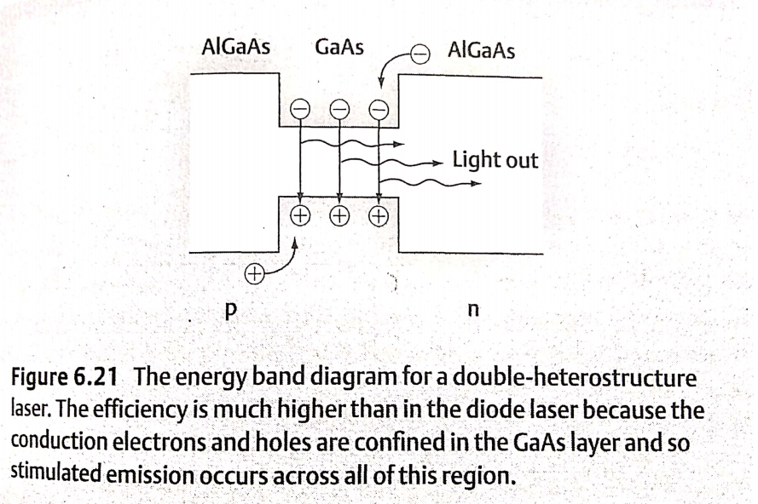
Since both the conduction electrons and holes collect in the same region, the proportion of events involving stimulated emission is greatly increased.

